Slide 1

Analysis of British Airways Reviews
The analysis aims to provide actionable insights into customer experiences and identify areas for improvement in service quality. The findings will support data-driven decision-making and enhance the overall customer experience.

Slide 2
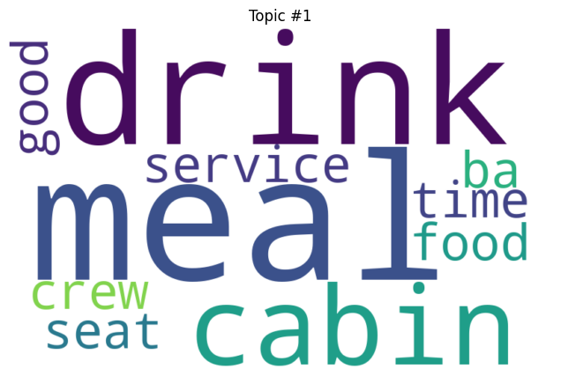
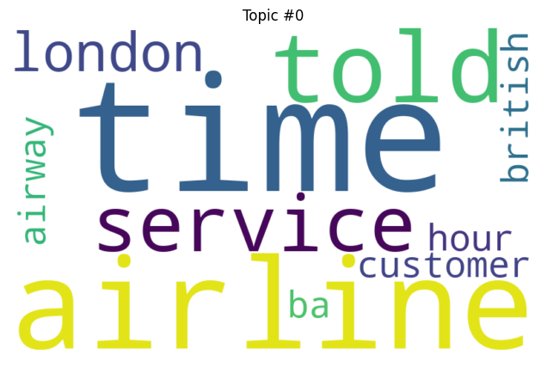
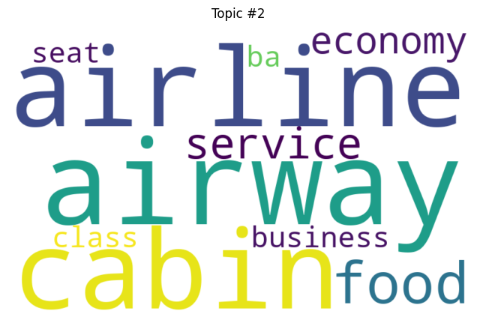
Insight: This topic highlights aspects of in-flight service, including the quality of meals and drinks, the cabin environment, and interactions with the crew. Positive terms like good are used, indicating that while there are complaints, some passengers might have had satisfactory experiences regarding food and service.
Insight: This topic seems to capture general issues and experiences related to the airline, especially focusing on time-related problems and the overall service. The mention of London and British indicates a geographical and brand-specific context, suggesting that many complaints or comments relate to the airline’s operations or service issues in specific locations.
Recommendations:
Address common service issues.
Improve communication and time management.
Focus on enhancing the in-flight experience across all classes.
Insight: This topic focuses on the differences between economy and business class, with mentions of food, service, and cabin suggesting discussions about the quality and experience in different seating classes. The presence of economy and business indicates a comparison of service levels and amenities between these classes.

